Slide 1

One-Way ANOVA
Reading: 5.1 – 5.4
exercises: Ch 5. 27, 37-38, 40
Assigned: hw 10
Producer: dr. mario
img credit: alex riegert-waters

Slide 2
ANOVA
Usage of ANOVA
Numerical Response Variable (Y)
Categorical Predictor Variable (X)
Questions to Answer:
Do different groups have different means?
How different are the means across groups?
One-Way ANOVA Implies There is One Predictor Variable

Slide 3
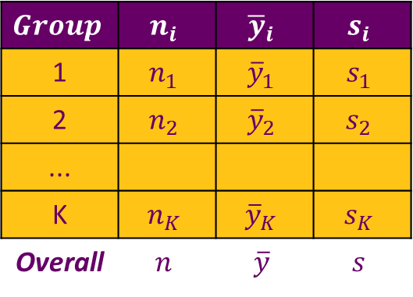
ANOVA
Data: Samples from Different Groups (K = # of Groups)
Summary Statistics
Test Hypotheses
$$Group$$ | $$n_{i}$$ | $${\overline{y}}_{i}$$ | $$s_{i}$$
1 | $$n_{1}$$ | $${\overline{y}}_{1}$$ | $$s_{1}$$
2 | $$n_{2}$$ | $${\overline{y}}_{2}$$ | $$s_{2}$$
...
K | $$n_{K}$$ | $${\overline{y}}_{K}$$ | $$s_{K}$$
Overall | $$n$$ | $$\overline{y}$$ | $$s$$
$H_{0}:μ_{1}=μ_{2}=⋯=μ_{K}$ vs. $H_{a}:Some μ_{i}≠μ_{j}$

Slide 4
Example: Grades on Different Exams
There are Four Different Exams (1, 2, 3, 4)
There are Five Students (Barb, Betsy, Bill, Bob, Bud)
Each Student Takes All Four Exams
Question: Is there a significant difference in the average grade among the four different exams?

Slide 5
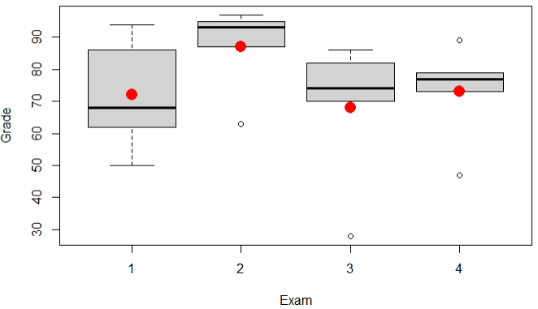
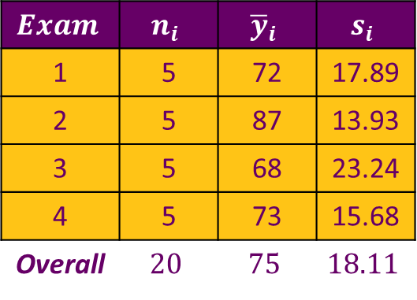
Supplement for Lecture 22
Inspect the Data
Calculate Various Summary Statistics
Use tapply() function
Visual of Relationship
Boxplot of Grades by Group
Plot Mean Grade by Group
Differences due to random chance?
$$Exam$$ | $$n_{i}$$ | $${\overline{y}}_{i}$$ | $$s_{i}$$
1 | 5 | 72 | 17.89
2 | 5 | 87 | 13.93
3 | 5 | 68 | 23.24
4 | 5 | 73 | 15.68
Overall | $$20$$ | $$75$$ | $$18.11$$

Slide 6


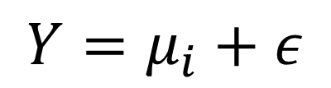
ANOVA
ANOVA (Means) Model
Under $H_{0}:All μ_{i} Are Equal→{\hat{μ}}_{i}=\overline{y}$ (overall mean)
Under $H_{a}:Some μ_{i}≠μ_{j}→{\hat{μ}}_{i}={\overline{y}}_{i}$ (group mean)
$$Y=μ_{i}+ε$$
Mean for Group #i
$$ε\sim N(0,σ_{ε})$$
Independent and Identically Distributed

Slide 7

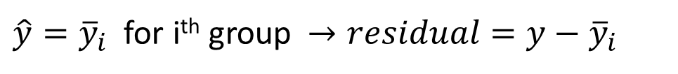
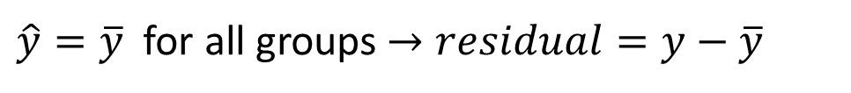
ANOVA
Making Prediction $\hat{Y}$ under $H_{0}$
Making Prediction $\hat{Y}$ under $H_{0}$
Question: Do we do “significantly” better with separate means?
$\hat{y}=\overline{y}$ for all groups $→residual=y−\overline{y}$
$\hat{y}={\overline{y}}_{i}$ for i^{th} group $→residual=y−{\overline{y}}_{i}$
$SSTotal=∑{\left(y−\overline{y}\right)}^{2}$ vs. $SSE=∑{\left(y−{\overline{y}}_{i}\right)}^{2}$

Slide 8

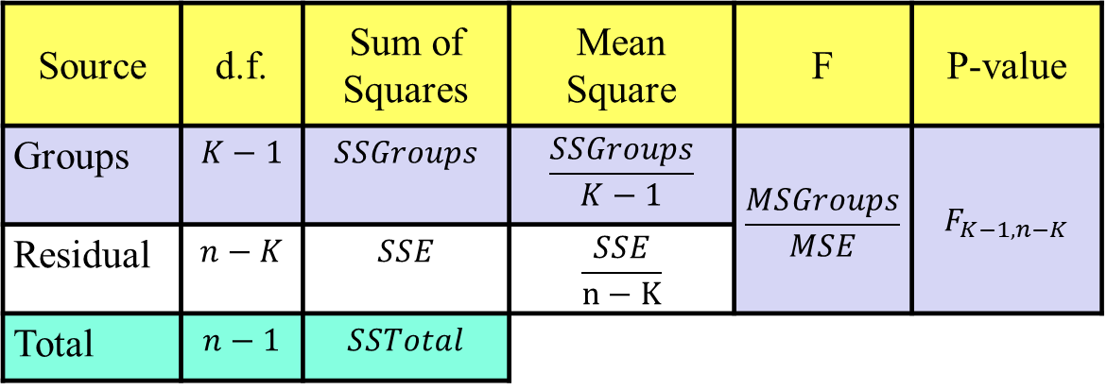
ANOVA
Partitioning Variability
ANOVA Table
$$SSTotal=SSGroups+SSE$$
$∑{\left(y−\overline{y}\right)}^{2}$ $=∑{\left({\overline{y}}_{i}−\overline{y}\right)}^{2}+∑{\left(y−{\overline{y}}_{i}\right)}^{2}$
Source | d.f. | Sum of Squares | Mean Square | F | P-value
Groups | $$K−1$$ | $$SSGroups$$ | $$\frac{SSGroups}{K−1}$$ | $$\frac{MSGroups}{MSE}$$ | $$F_{K−1,n−K}$$
Residual | $$n−K$$ | $$SSE$$ | $$\frac{SSE}{n−K}$$
Total | $$n−1$$ | $$SSTotal$$

Slide 9
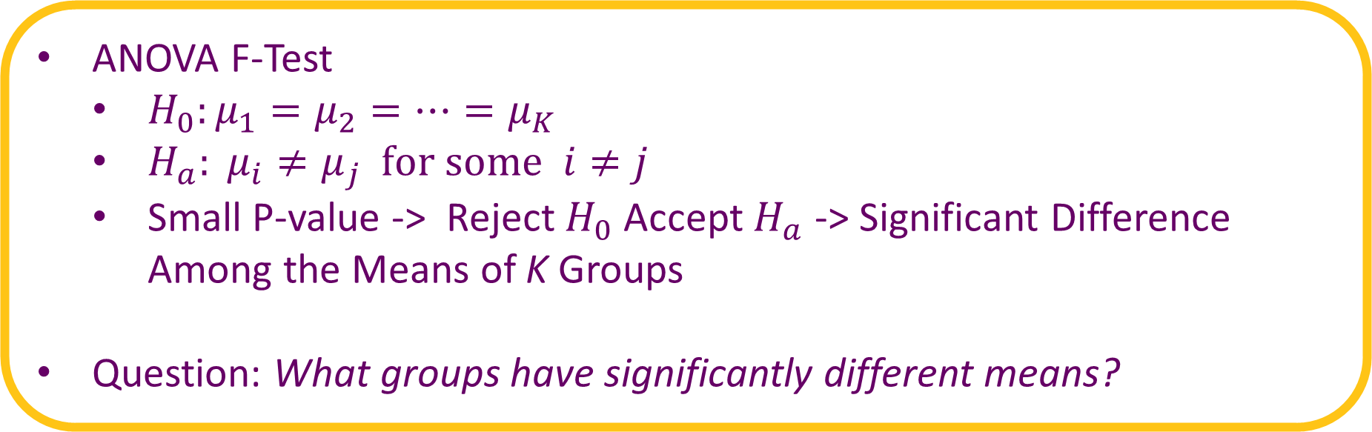
ANOVA
ANOVA F-Test
$H_{0}:μ_{1}=μ_{2}=⋯=μ_{K}$
$H_{a}: μ_{i}≠μ_{j} for some i≠j$
Small P-value -> Reject $H_{0}$ Accept $H_{a}$ -> Significant Difference Among the Means of K Groups
Question: What groups have significantly different means?

Slide 10
Supplement for Lecture 22
Visual of Relationship
Calculate SSTotal, SSE, SSGroups
ANOVA F-test Using aov() function
Interpret Results (P-value = 0.395)

Slide 11

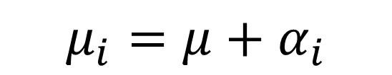

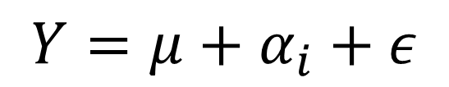
Alternate ANOVA
ANOVA (Effects) Model
Mean for Group i
Estimation of Parameters
$\hat{μ}=\overline{y}$
${\hat{α}}_{i}=\overline{y_{i}}−\overline{y}$
$$Y=μ+α_{i}+ε$$
Overall Mean
$$ε\sim N(0,σ_{ε})$$
Independent and Identically Distributed
Effect for
Group #i
$$μ_{i}=μ+α_{i}$$

Slide 12

Alternate ANOVA
Before
$H_{0}:μ_{1}=μ_{2}=⋯=μ_{K}$
$H_{a}: μ_{i}≠μ_{j} for some i≠j$
Now
$H_{0}:α_{1}=α_{2}=⋯=α_{k}=0$
$H_{a}:{Some α}_{i}≠0$
These Hypotheses are Equivalent

Slide 13


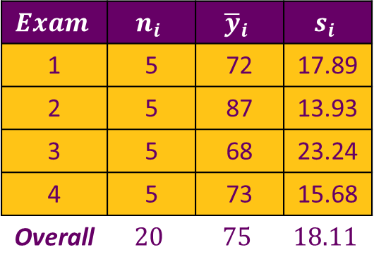
Example: Grades on Different Exams
Recall Data
Estimate of Grand Mean
$\hat{μ}=\overline{y}=75$
Estimates of Effects
${\hat{α}}_{1}=\overline{y_{1}}−\overline{y}=72−75=−3$
${\hat{α}}_{2}=\overline{y_{2}}−\overline{y}=87−75=12$
${\hat{α}}_{3}=\overline{y_{3}}−\overline{y}=68−75=−7$
${\hat{α}}_{4}=\overline{y_{4}}−\overline{y}=73−75=−2$
$$Exam$$ | $$n_{i}$$ | $${\overline{y}}_{i}$$ | $$s_{i}$$
1 | 5 | 72 | 17.89
2 | 5 | 87 | 13.93
3 | 5 | 68 | 23.24
4 | 5 | 73 | 15.68
Overall | $$20$$ | $$75$$ | $$18.11$$
$${∑\hat{α}}_{i}=0$$

Slide 14
Supplement for Lecture 22
Plots of Residuals from ANOVA
Examine Standard Deviations of the Different Exams

Slide 15


Conditions for ANOVA
Recall:
Zero Mean: Always Holds for Sample Residuals
Constant Variance: Compare Standard Deviations of Groups
Normality: Histogram or QQ Plot of Residuals
Independence & Randomness: Details About the Data Collection
$$ε\sim N(0,σ_{ε})$$
$$iid$$

Slide 16
Thank You
Make Reasonable Decisions

